Slide 1
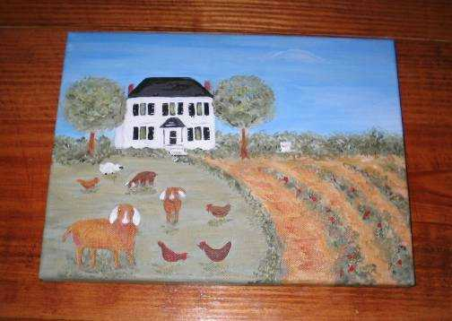
Pampatike Organic Farm
King William, VA

Slide 2

Land Cover & Management
117 acres (40 in pasture/hay; 72 in hardwood forests; 4 in wetlands/beaver ponds; 1 for farmstead)
Protected by Conservation Easement
Certified Naturally Grown
No hormones, pesticides, or chemical fertilizers

Slide 3
Farm Products
Nubian dairy goats (milk & animal sales)
Free-range chickens & eggs
Organic vegetables
Organic honey
Organic hay
Livestock guardian dogs
Value-added products (goat cheese, fudge, cheesecake, salsa)
Farmer’s markets & on-farm sales

Slide 4
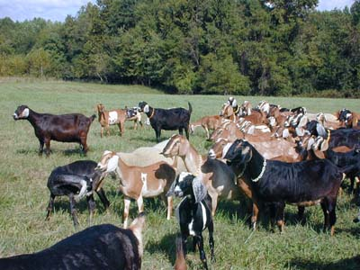
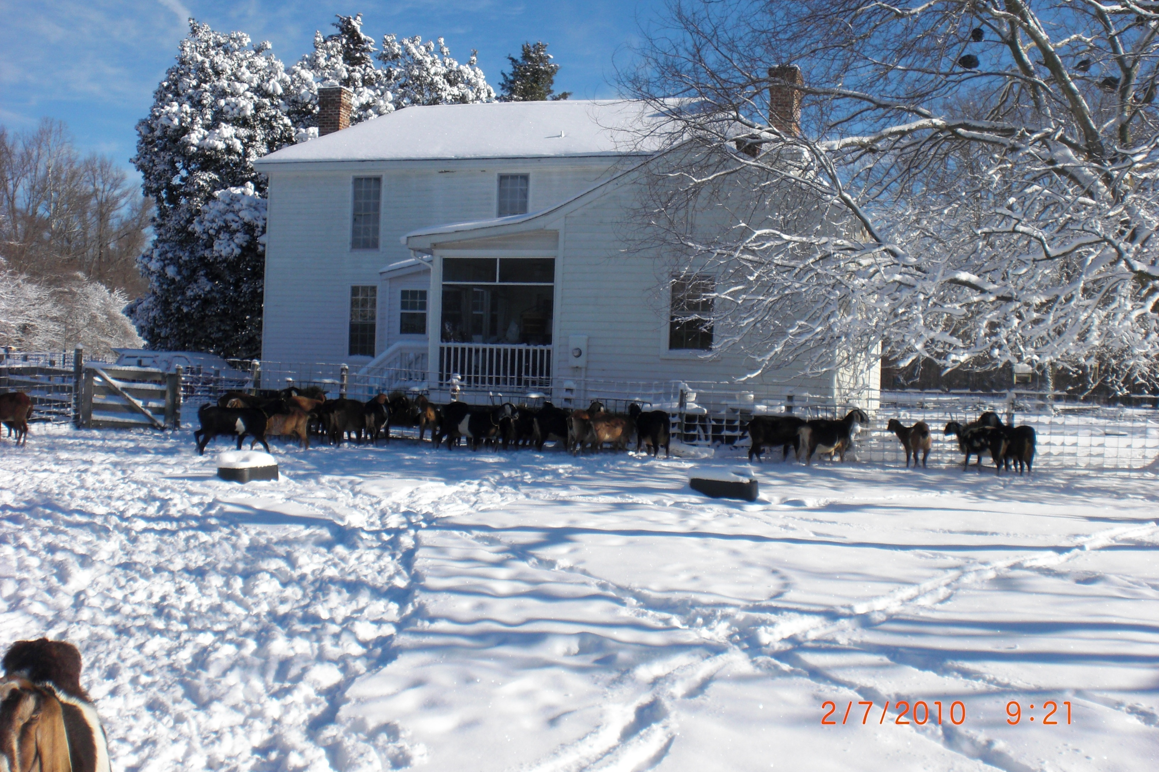
Dairy Goats
Pastured All Year
Supplemented with Hay & Grain

Slide 5
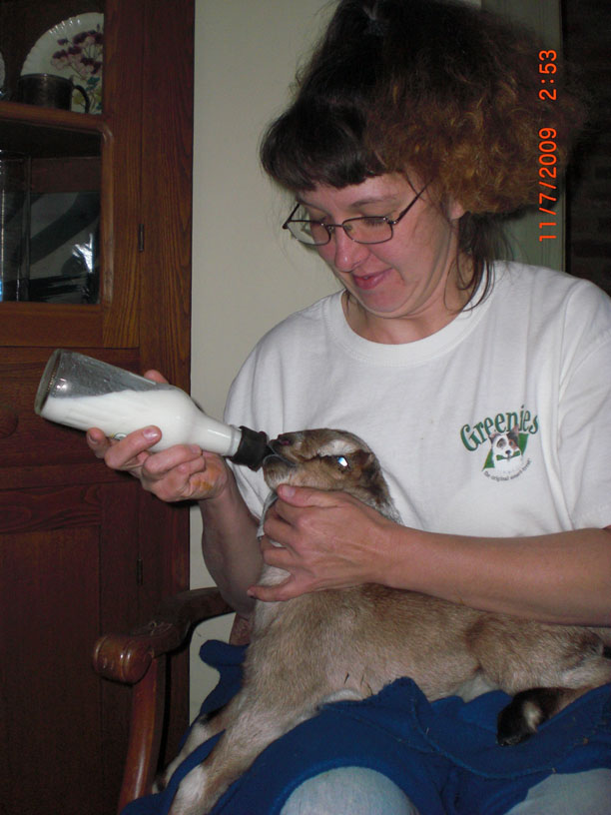
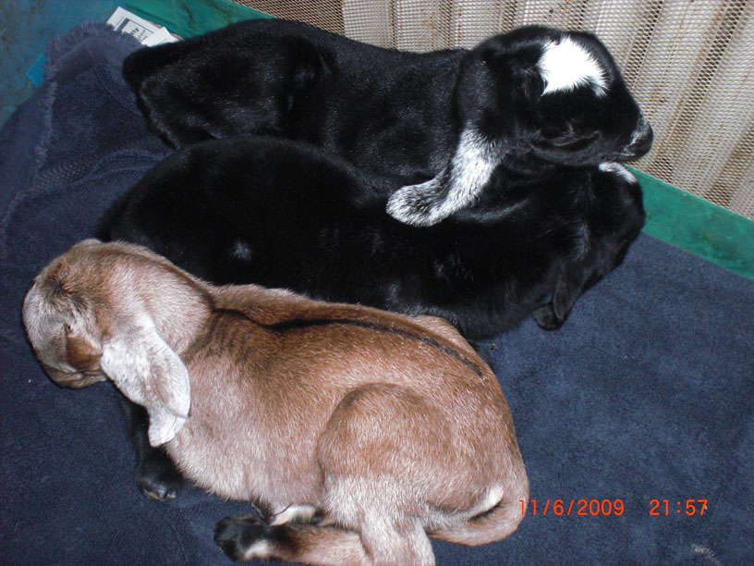
Kidding Season
1st Day in Crib in House
1st Feedings by Bottle

Slide 6
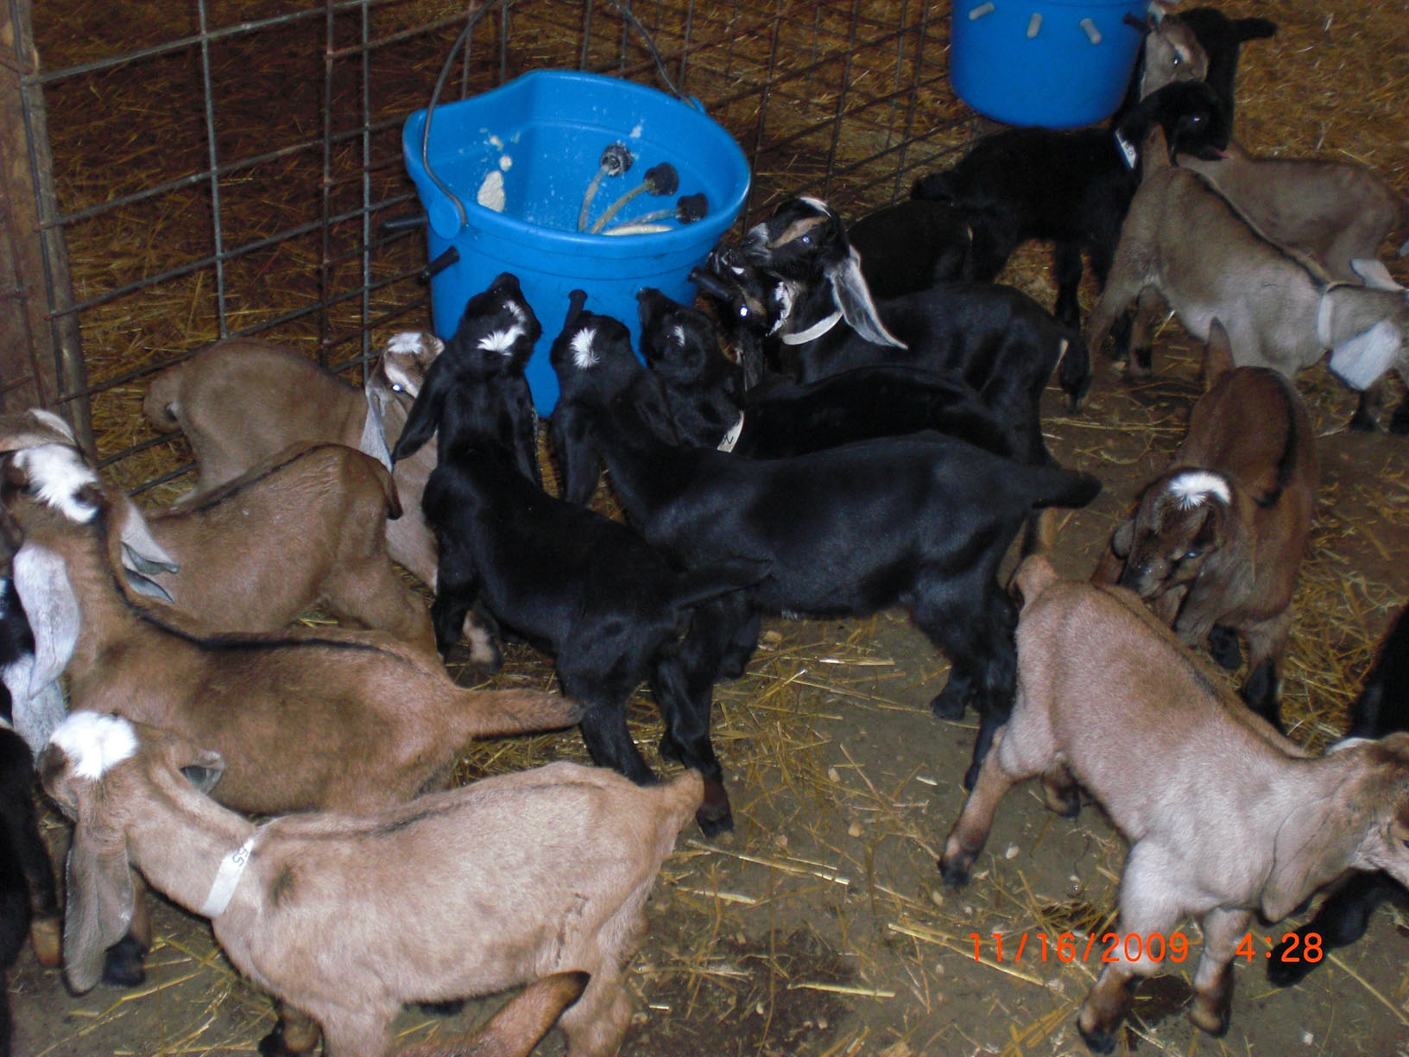
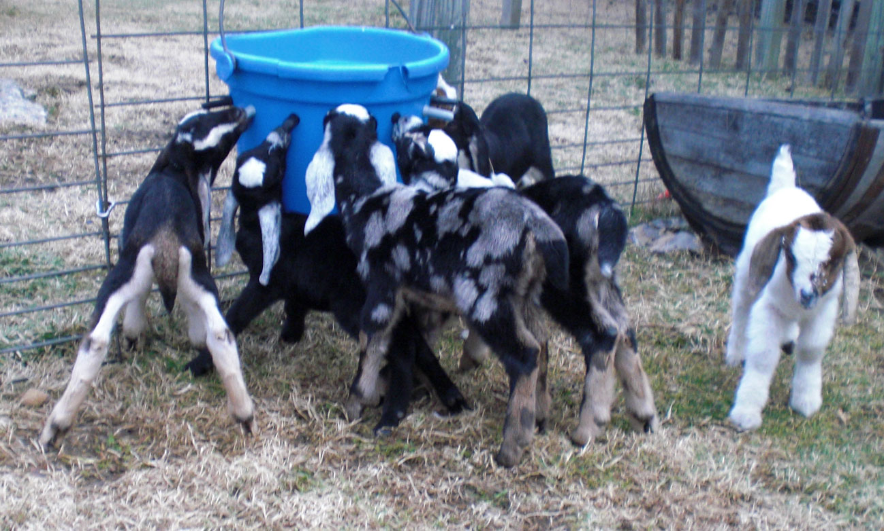
Outside and To The Barn
Lamb Bar Feeding for 3 Months
A Nipple for Everyone

Slide 7
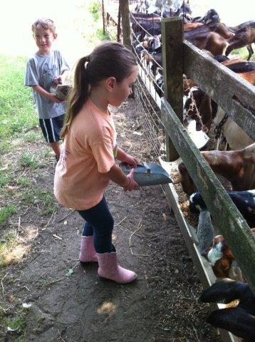
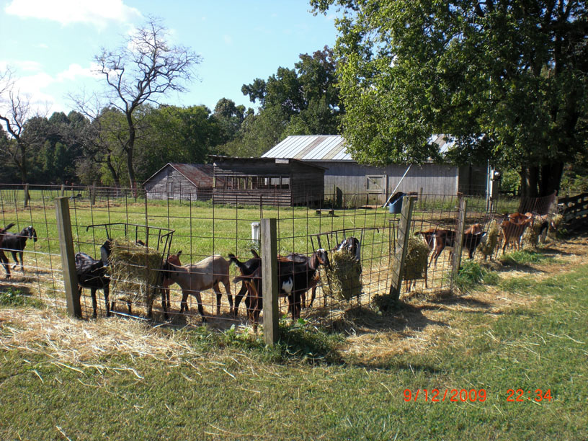
Hay and Grain Feeding
Nibble Grain & Hay @ 2 wks
Chow Line at the Feed Trough

Slide 8
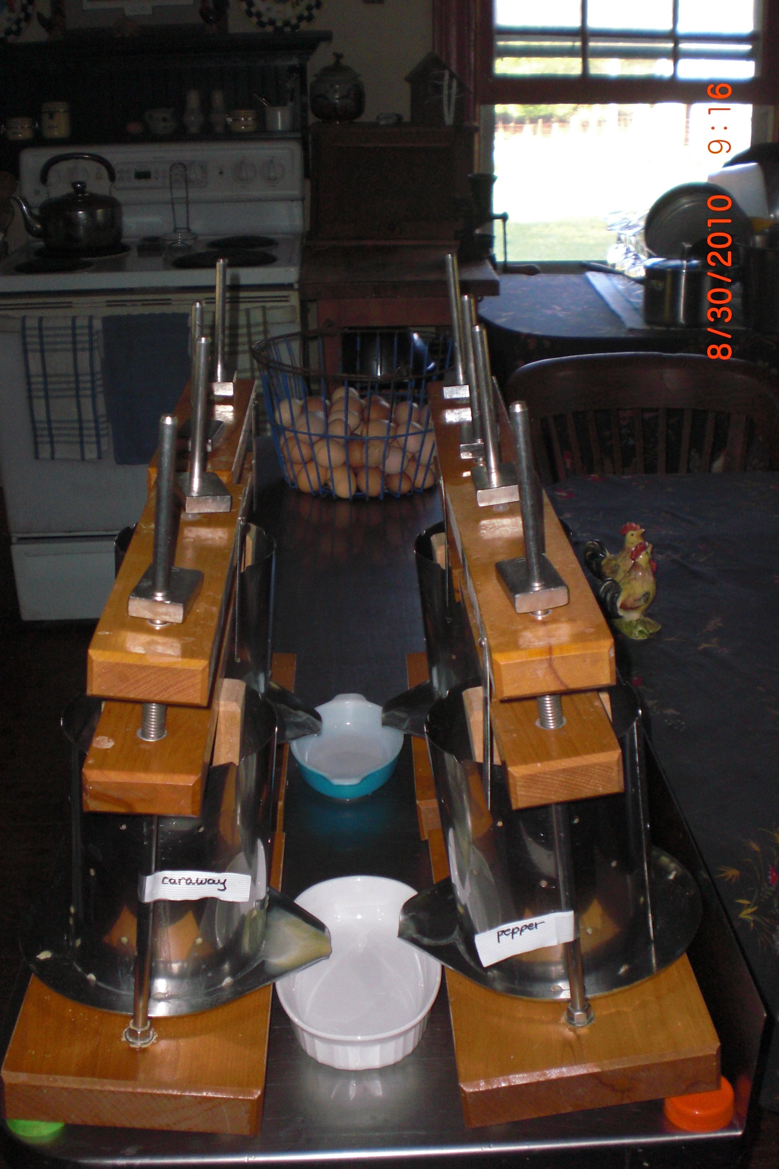
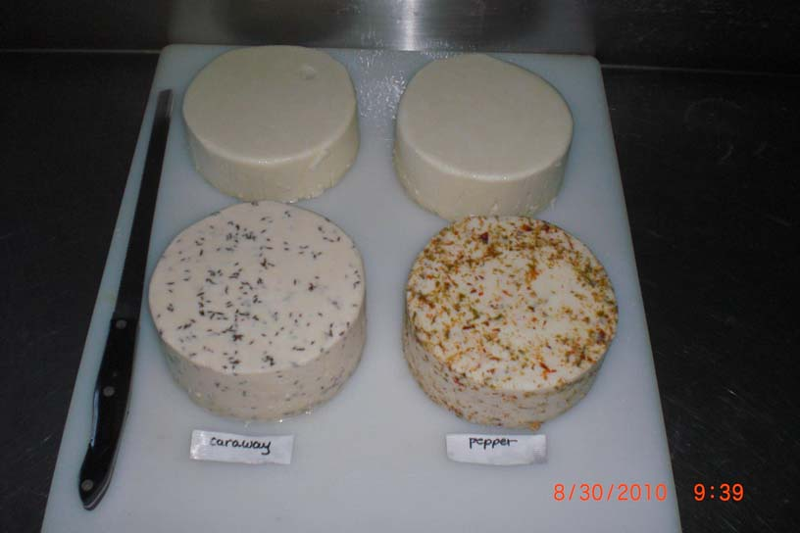
Cheesemaking
Cheese Presses for Hard Cheeses
Final Products: Feta, Caraway Jack & Pepper Jack

Slide 9
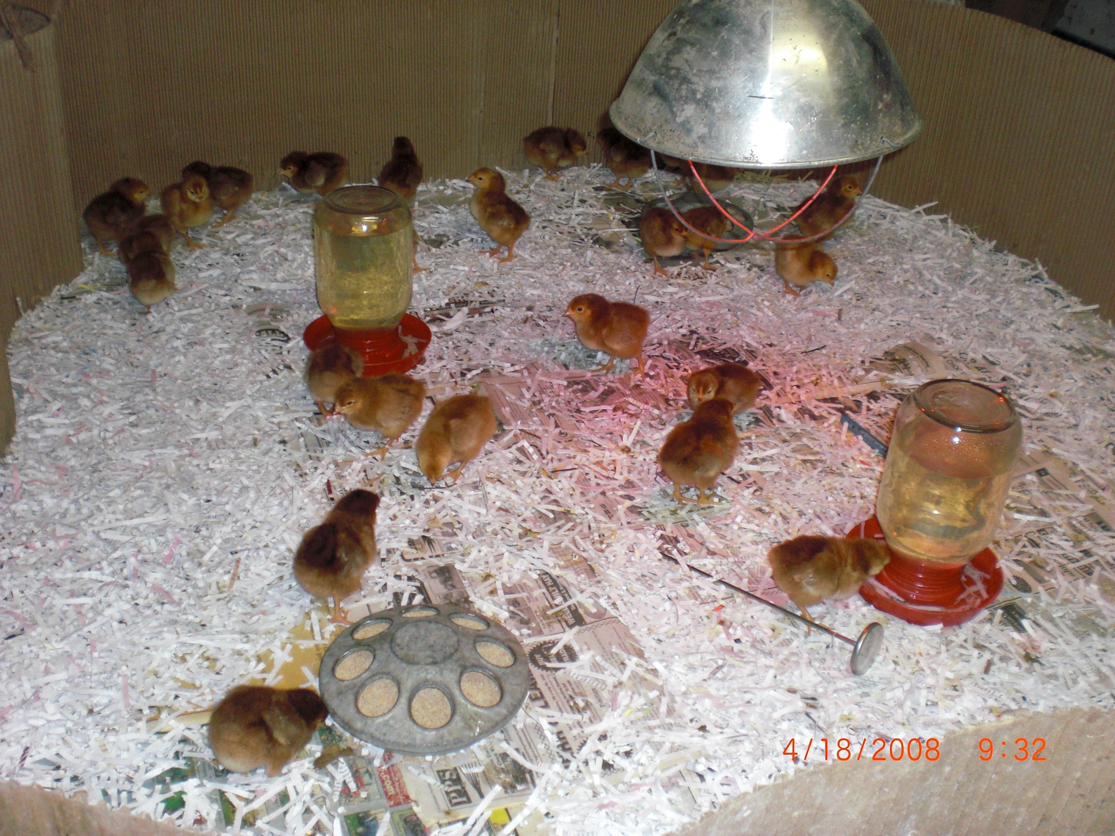
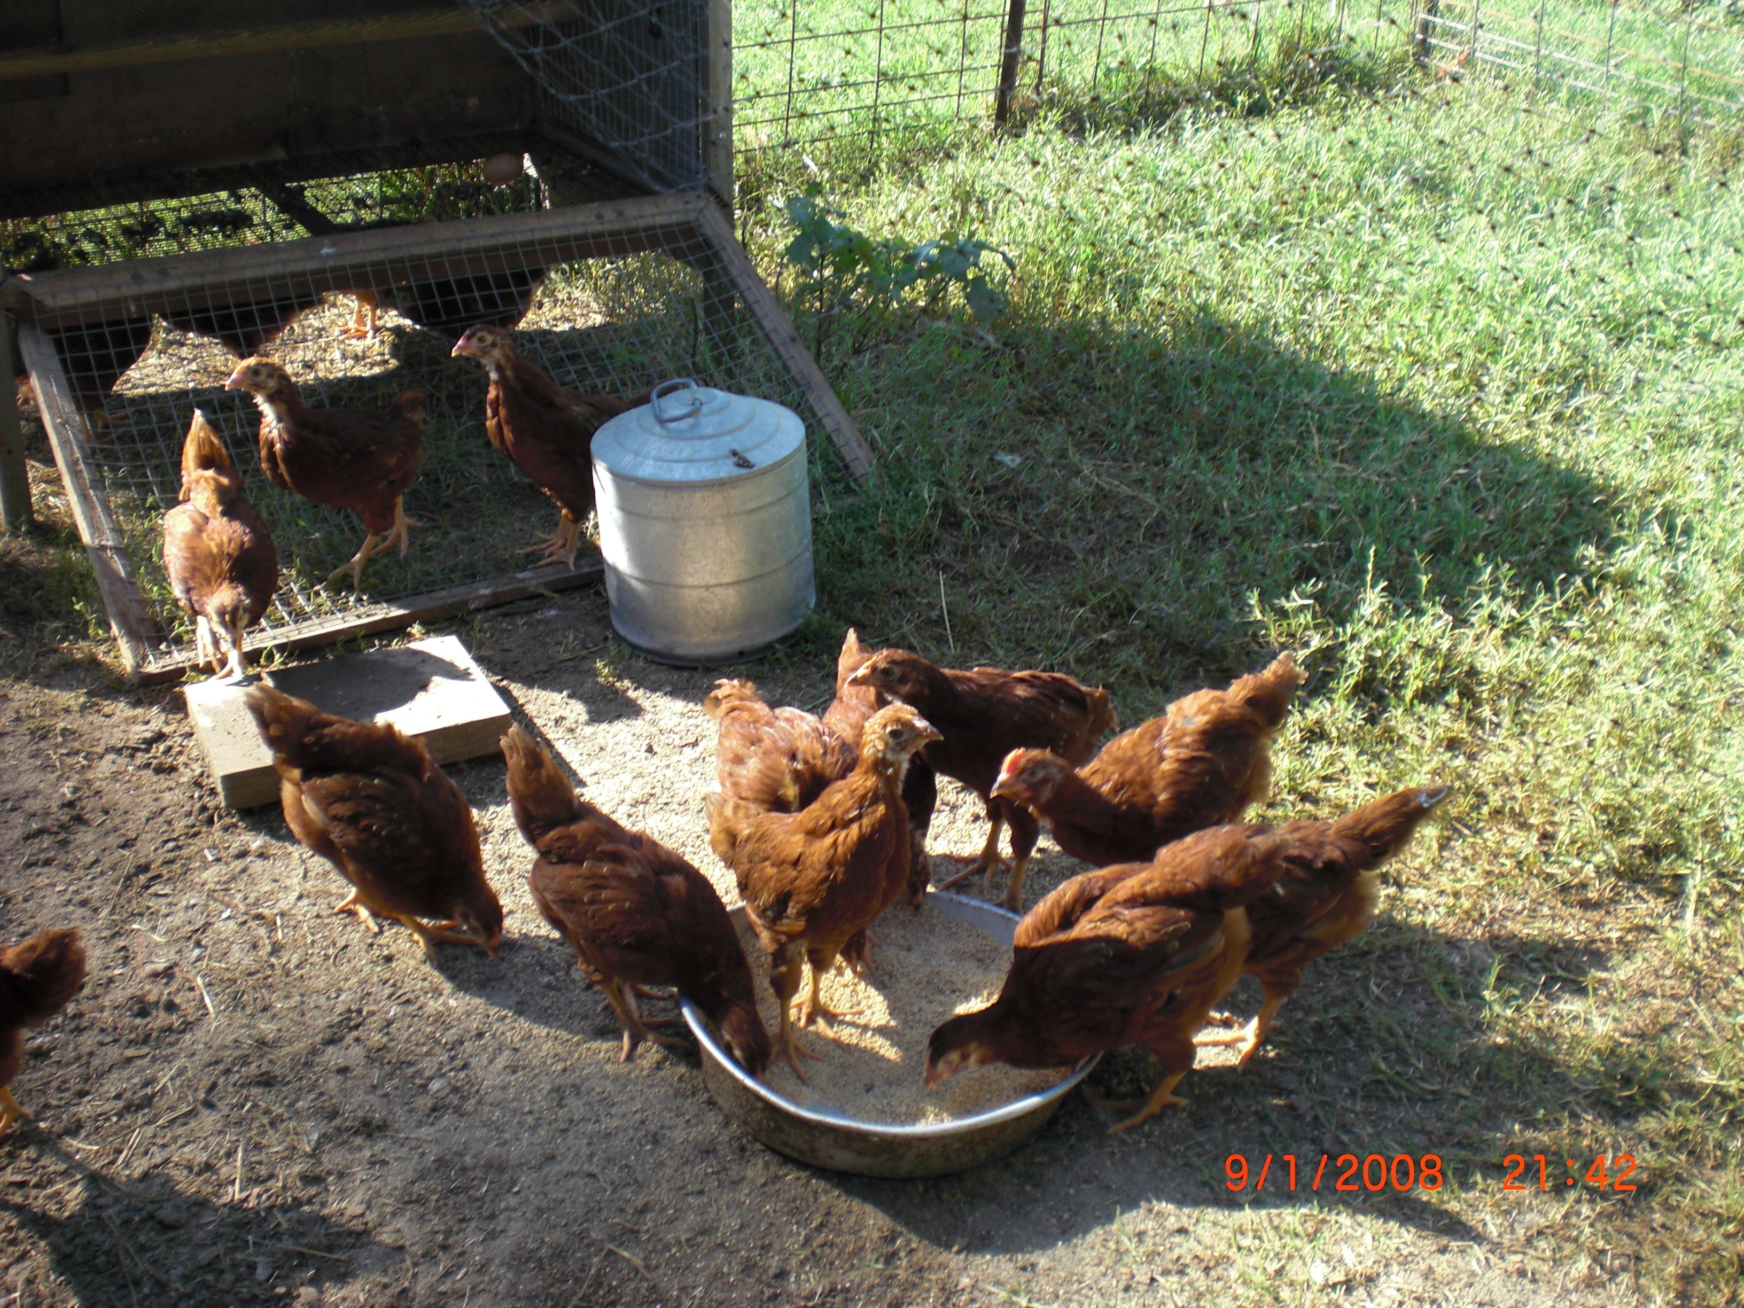
Free-Range Chickens
Day Old Chicks in Brooder
Fully Feathered & Outside in Chick Yard

Slide 10
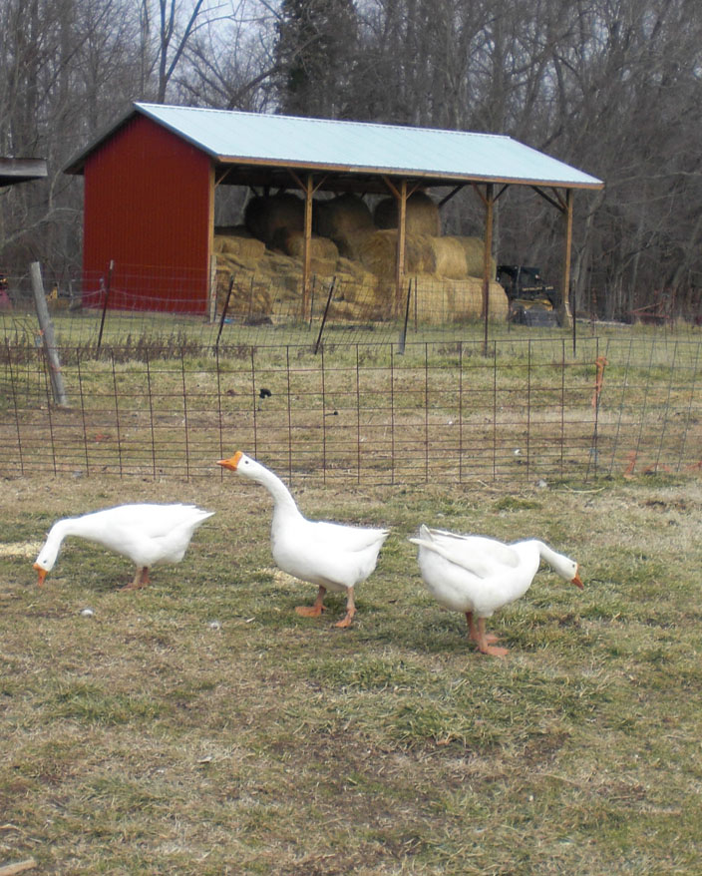
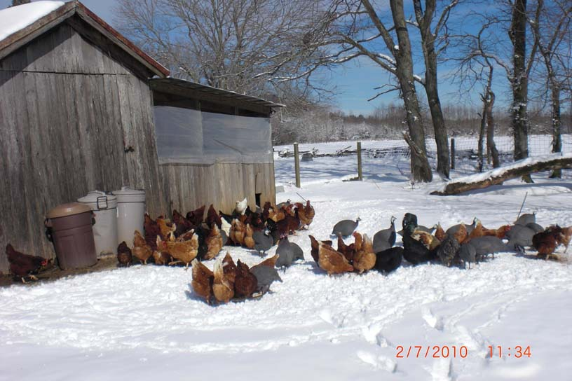
Nutritious Eggs
1⁄3 less cholesterol; 1⁄4 less saturated fat; 2⁄3 more vitamin; 2 x more omega-3 fatty acids; 3 x more vitamin E; 7 x more beta carotene
Full Grown Layers
Ducks, Geese & Guinea Fowl

Slide 11
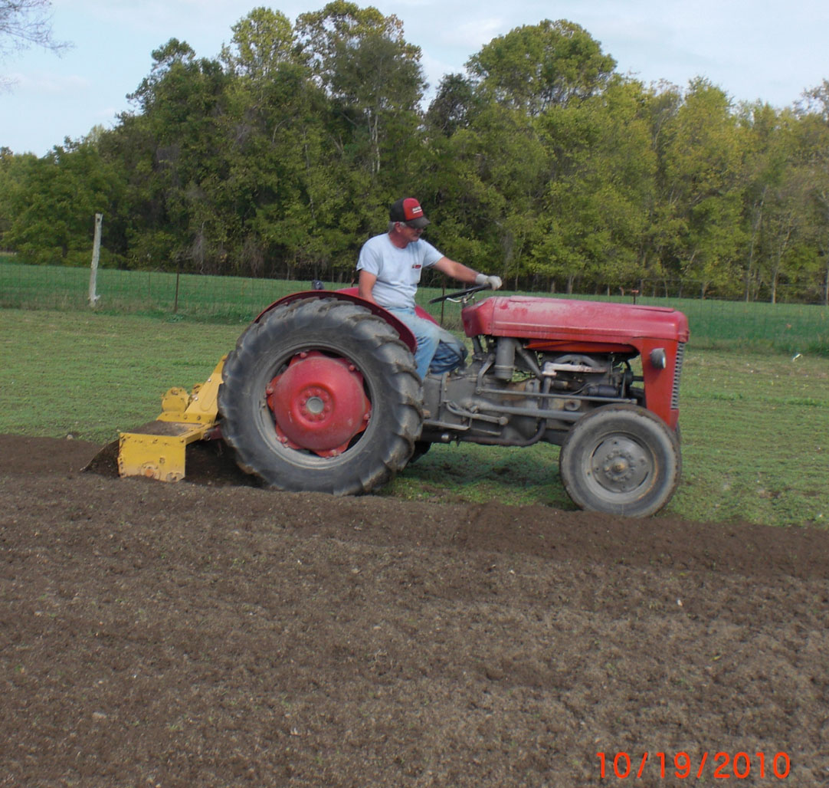
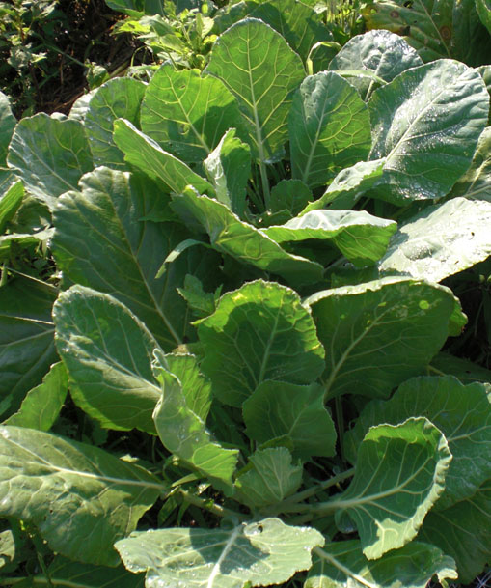
Organic Vegetables
Preparing the Soil & Seedbed
Productivity from Composted Manure

Slide 12
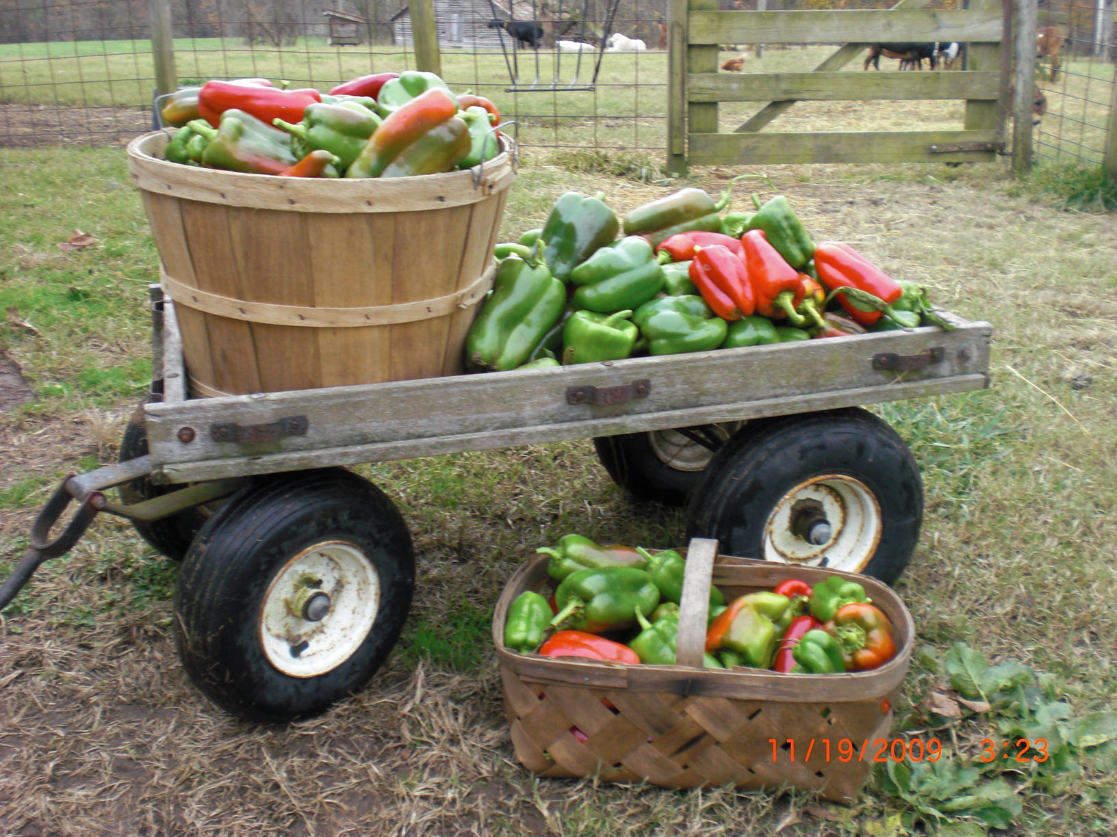
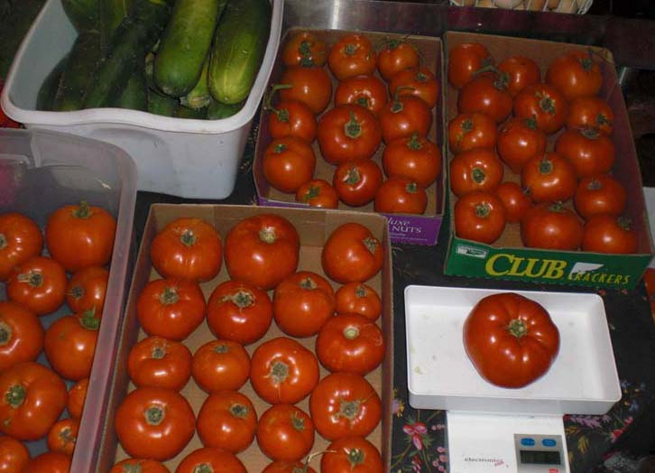
The Bounty
Peppers: Sweet & Hot Varieties
Tomatoes: Heirloom Slicers

Slide 13
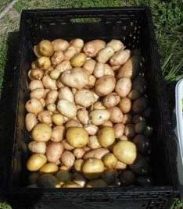
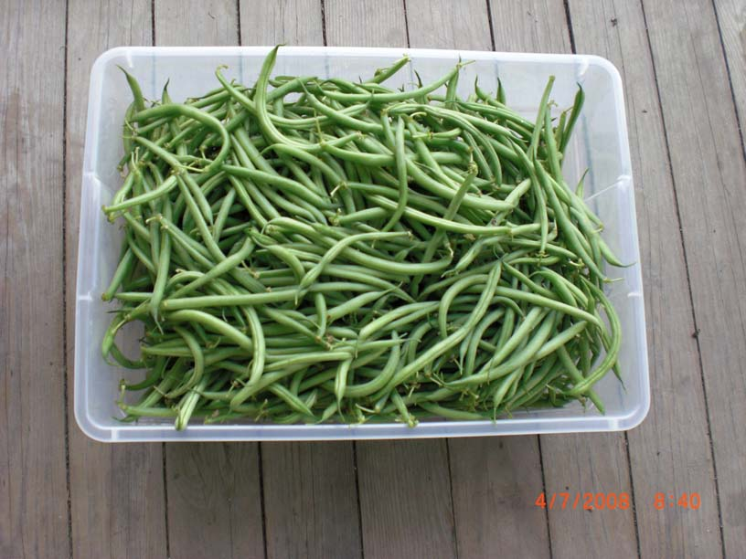
Potatoes, Beans, Squash, Greens, Eggplant, Garlic, Turnips, Beets & More

Slide 14
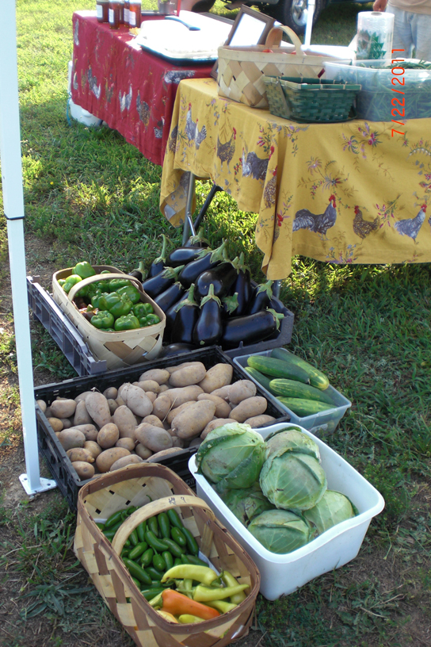
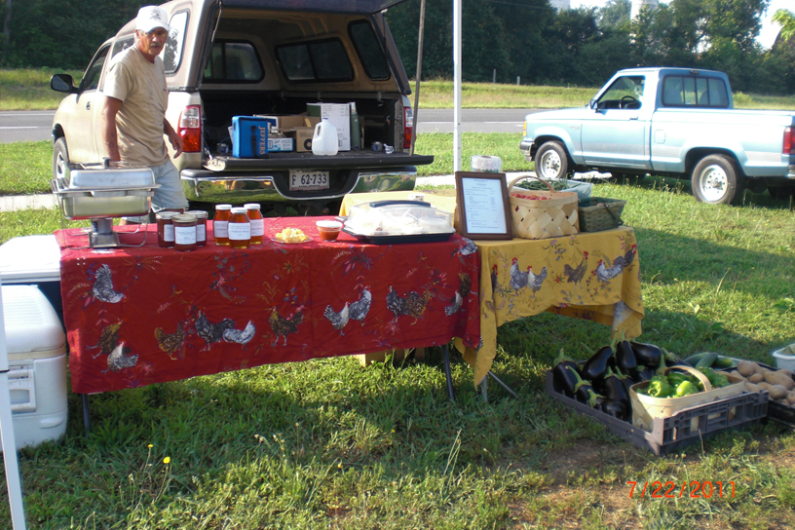
At the Market

Slide 15
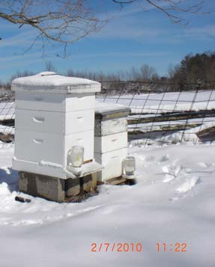
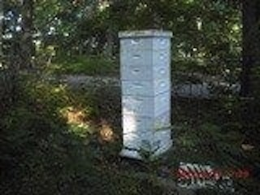
Honey Bees
Raised Organically
No Pesticides or Chemical Treatments

Slide 16
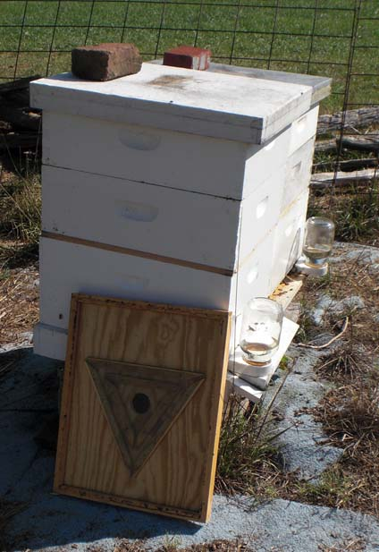
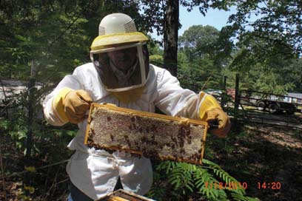
Honey Extraction
Examining Honey Frame
Bee Escape

Slide 17
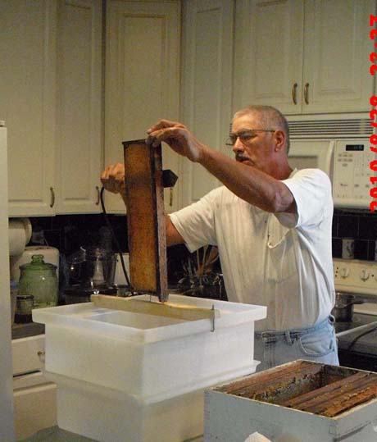
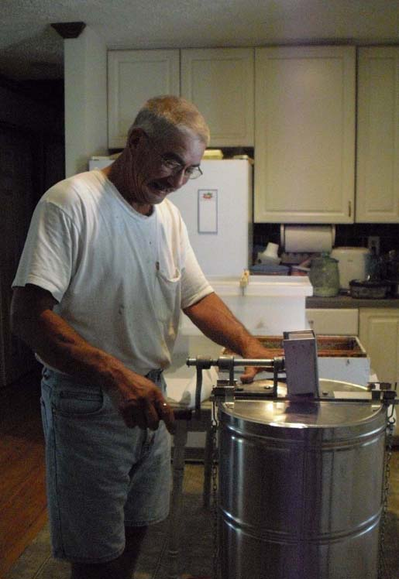
Decapping Honey Frame
Spinning Honey Frames

Slide 18
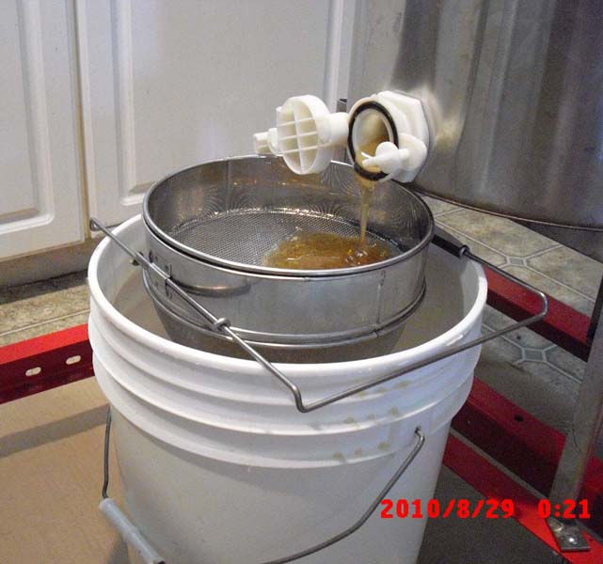
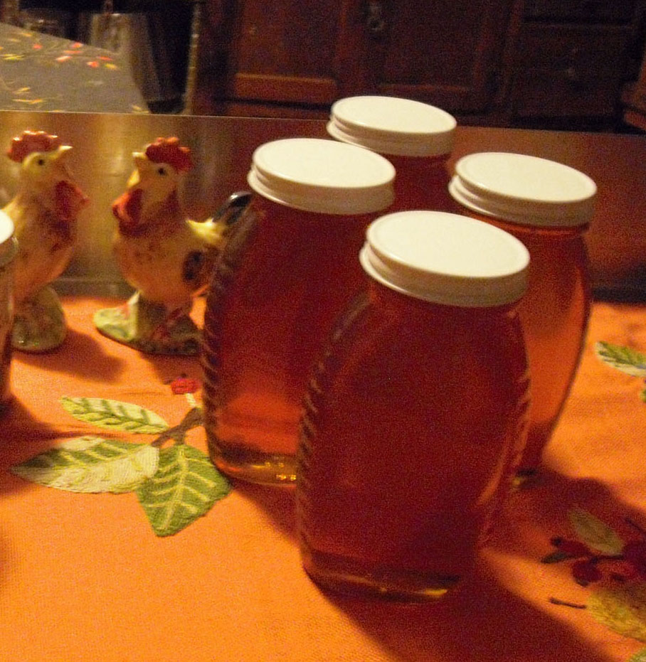
Honey is Strained Before Going into Honey Bucket
The Finished Product

Slide 19
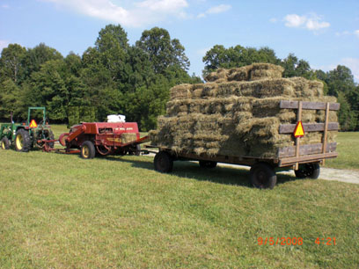
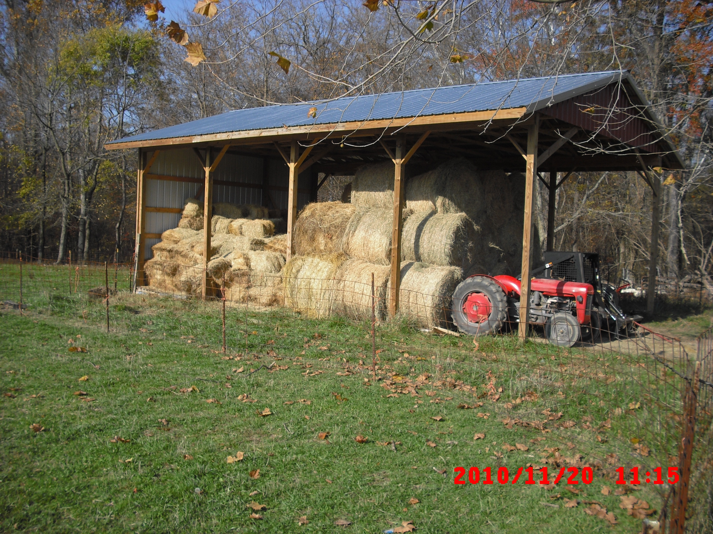
Make Hay While the Sun Shines
Goal: 3 Cuttings a Season
Round and Square Bales

Slide 20
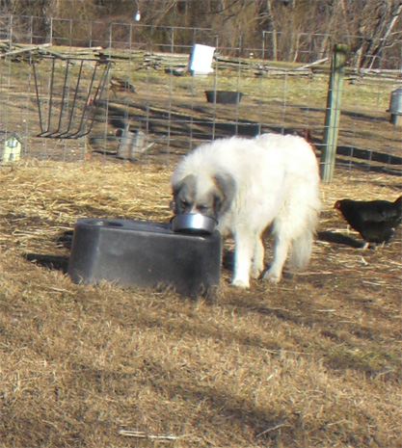
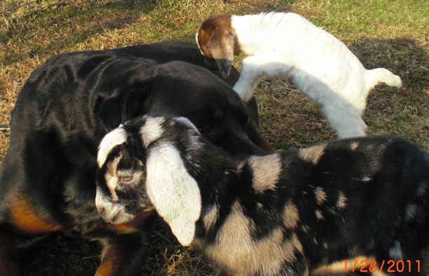
The Dogs
The Rottweiler is Very Patient with the Kids
Great Pyrenees Guardian Dogs

Slide 21
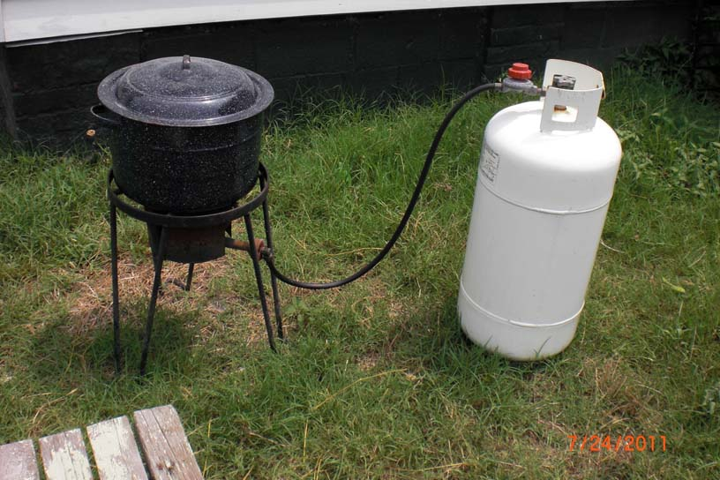
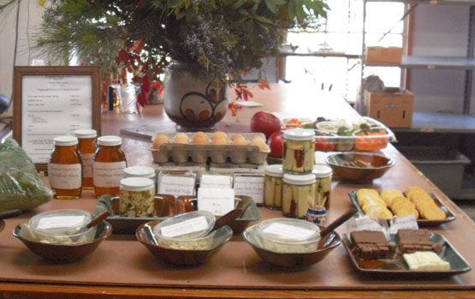
Value-Added Products
Canning Salsa
Sales Appeal

Slide 22
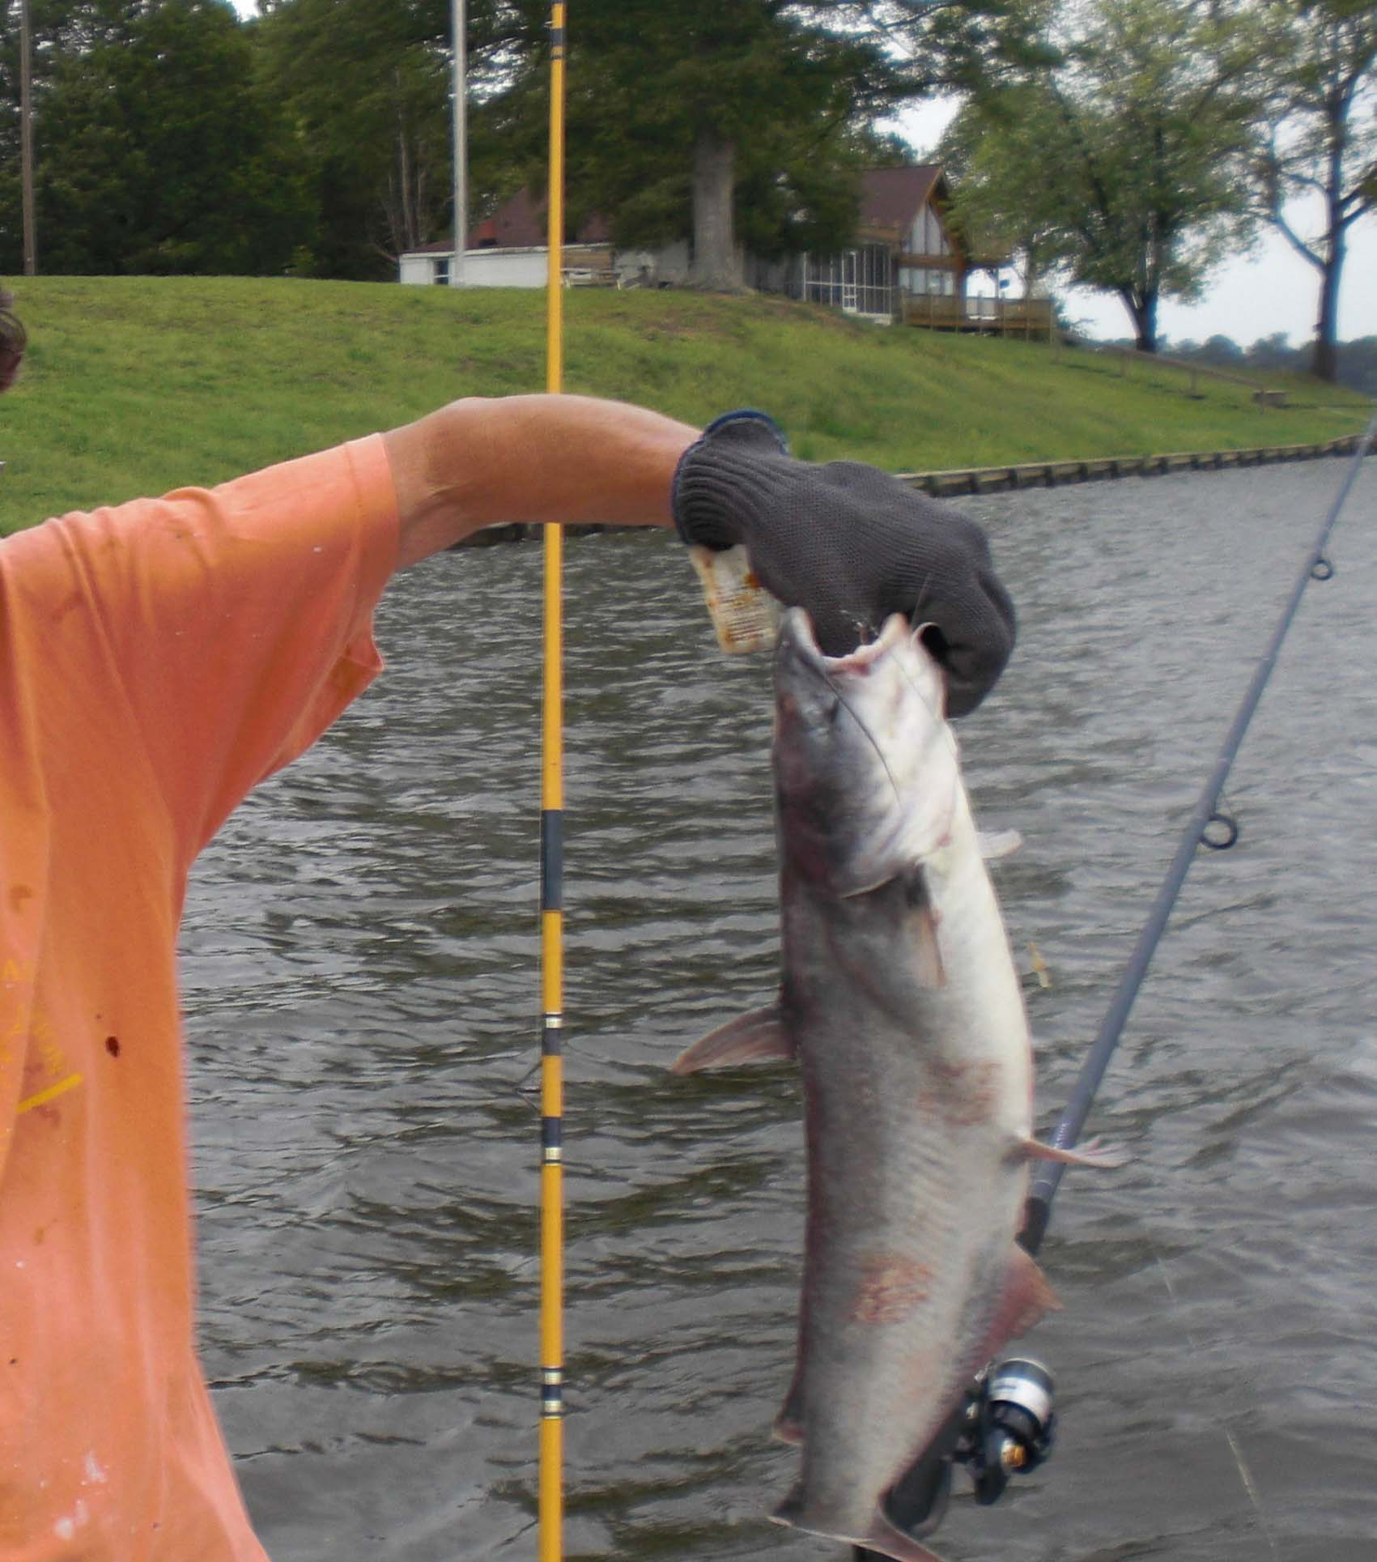
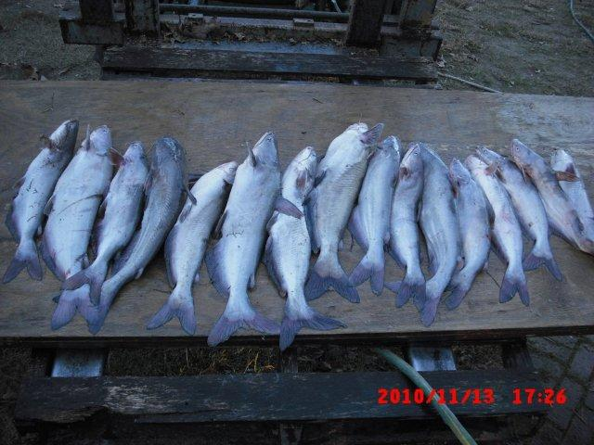
In Our “Spare Time”
Fishing on the Mattaponi & Pamunkey Rivers
Blue Cat

Slide 23
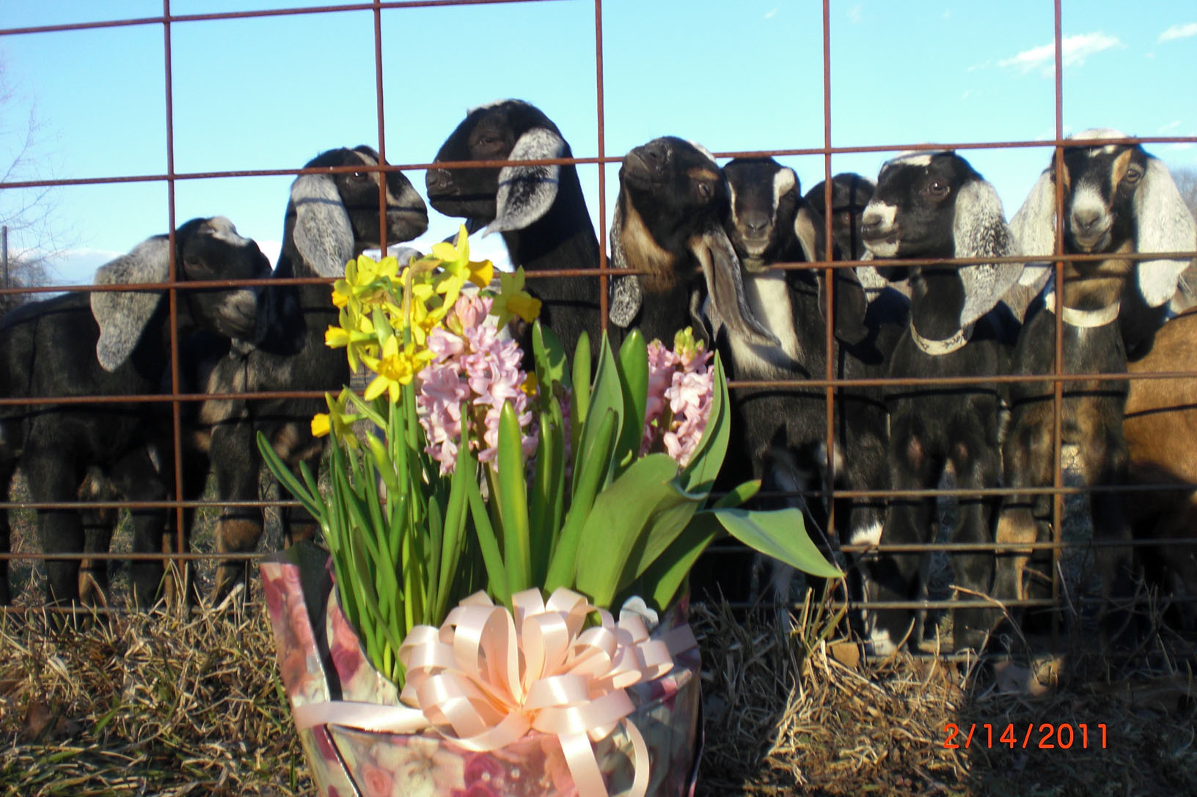
The End

